Slide 1
State-of-the-art Convolutional Neural Networks

Slide 2
~14 million labeled images, 20k classes
Images gathered from Internet
Human labels via Amazon MTurk
ImageNet Large-Scale Visual Recognition Challenge (ILSVRC): 1.2 million training images, 1000 classes

Slide 3
AlexNet

Slide 4
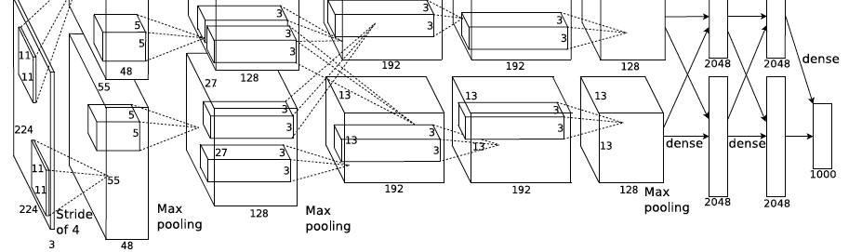
Alexnet – ILSVRC 2012 winner
The network was made up of 5 conv layers, max-pooling layers, dropout layers, and 3 fully connected layers.
Reduced test error rate to 15.4%

Slide 5
Summary of AlexNet
Trained the network on ImageNet data, which contained over 15 million annotated images from a total of over 22,000 categories.
Used ReLU for the nonlinearity functions (Found to decrease training time as ReLUs are several times faster than the conventional tanh function).
Used data augmentation techniques that consisted of image translations, horizontal reflections, and patch extractions.
Implemented dropout layers in order to combat the problem of overfitting to the training data.
Trained the model using batch stochastic gradient descent, with specific values for momentum and weight decay.
Trained on two GTX 580 GPUs for five to six days.

Slide 6
ZFNet

Slide 7
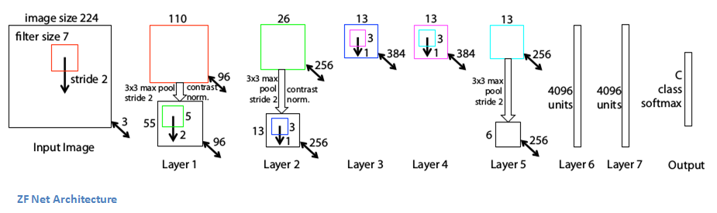
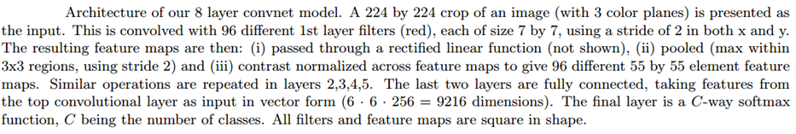
ZFnet – ILSVRC 2013 winner
Reduced test error rate to 11.2%

Slide 8
Summary of ZFNet
Very similar architecture to AlexNet, except for a few minor modifications.
AlexNet trained on 15 million images, while ZF Net trained on only 1.3 million images.
Instead of using 11x11 sized filters in the first layer (which is what AlexNet implemented), ZF Net used filters of size 7x7 and a decreased stride value. The reasoning behind this modification is that a smaller filter size in the first conv layer helps retain a lot of original pixel information in the input volume. A filtering of size 11x11 proved to be skipping a lot of relevant information, especially as this is the first conv layer.
As the network grows, we also see a rise in the number of filters used.
Used ReLUs for their activation functions, cross-entropy loss for the error function, and trained using batch stochastic gradient descent.
Trained on a GTX 580 GPU for twelve days.

Slide 9
VGGNet

Slide 10
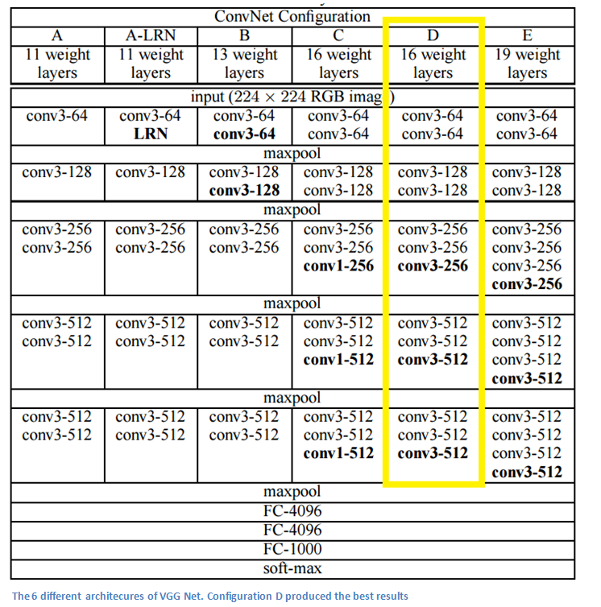
VGGnet – ILSVRC 2014 (2nd place)
19 layer CNN that strictly used 3x3 filters with stride and pad of 1, along with 2x2 maxpooling layers with stride 2
Reduced test error rate to 7.3%

Slide 11
Summary of VGGNet
The use of only 3x3 sized filters is quite different from AlexNet’s 11x11 filters in the first layer and ZF Net’s 7x7 filters. The authors’ reasoning is that the combination of two 3x3 conv layers has an effective receptive field of 5x5. This in turn simulates a larger filter while keeping the benefits of smaller filter sizes. One of the benefits is a decrease in the number of parameters. Also, with two conv layers, we’re able to use two ReLU layers instead of one.
3 conv layers back to back have an effective receptive field of 7x7.
As the spatial size of the input volumes at each layer decrease (result of the conv and pool layers), the depth of the volumes increase due to the increased number of filters as you go down the network.
Interesting to notice that the number of filters doubles after each maxpool layer. This reinforces the idea of shrinking spatial dimensions, but growing depth.
Used scale jittering as one data augmentation technique during training and used ReLU layers after each conv layer and trained with batch gradient descent.
Trained on 4 Nvidia Titan Black GPUs for two to three weeks.

Slide 12
GoogleNet

Slide 13
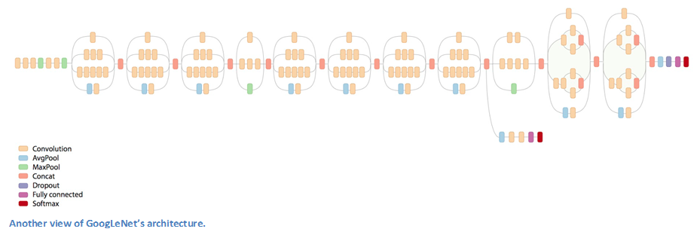
GoogleNet – ILSVRC 2014 winner
22 layer CNN
Reduced test error rate to 6.7%

Slide 14
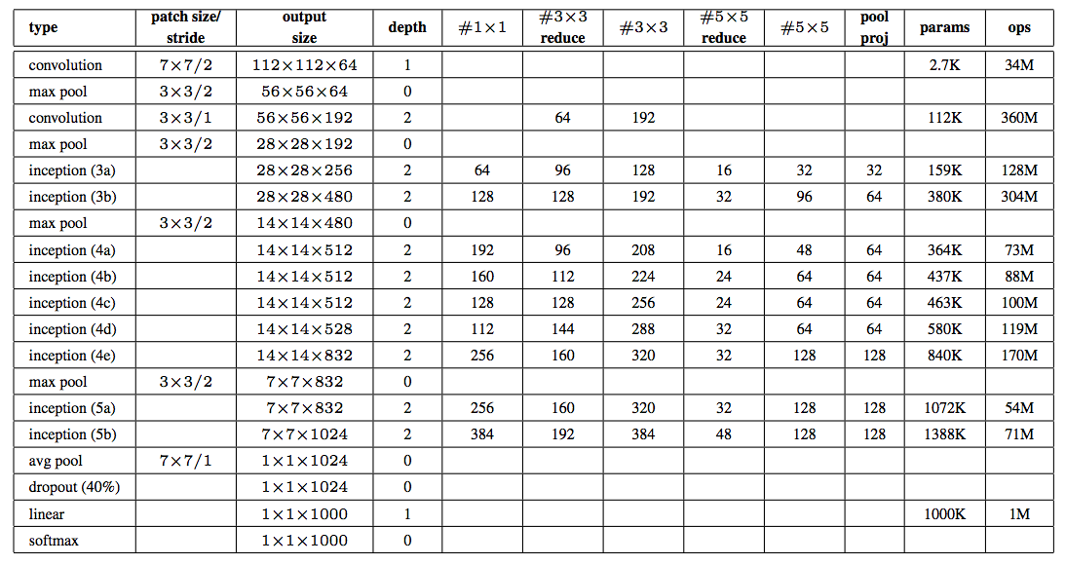
GoogleNet – ILSVRC 2014 winner

Slide 15
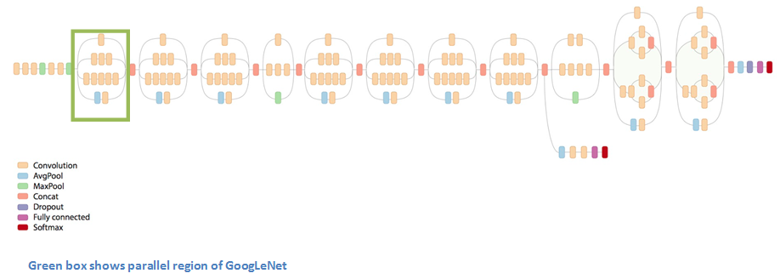
Inception Idea

Slide 16
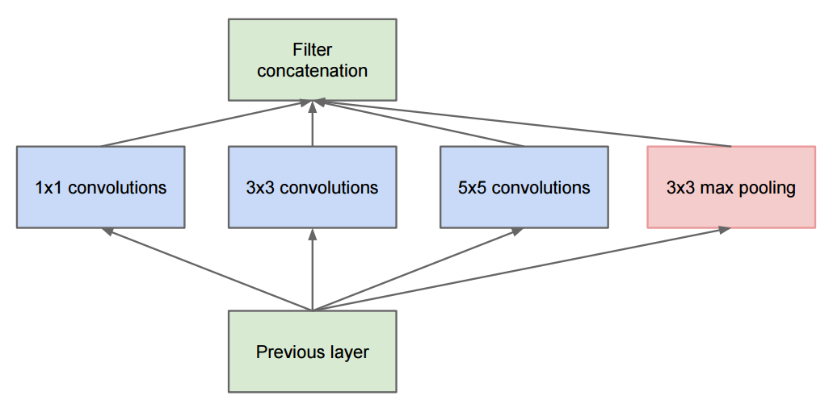
Naïve Inception Idea
At each layer of a traditional ConvNet, you have to make a choice of whether to have a pooling operation or a conv operation (there is also the choice of filter size). What an Inception module allows you to do is perform all of these operations in parallel.

Slide 17
Naïve Inception Idea
This network would end up with an extremely large depth channel for the output volume. How do you reduce the depth dimension of feature maps?
By adding 1x1 conv operations before the 3x3 and 5x5 layers. The 1x1 convolutions (or network in network layer) provide a method of dimensionality reduction
These 1x1 conv layers are followed by ReLU units which adds more non-linearity to network
Example: Assume an input to any layer is: 100x100x60. Applying 20 filters of 1x1 convolution would allow you to reduce the volume to 100x100x20

Slide 18
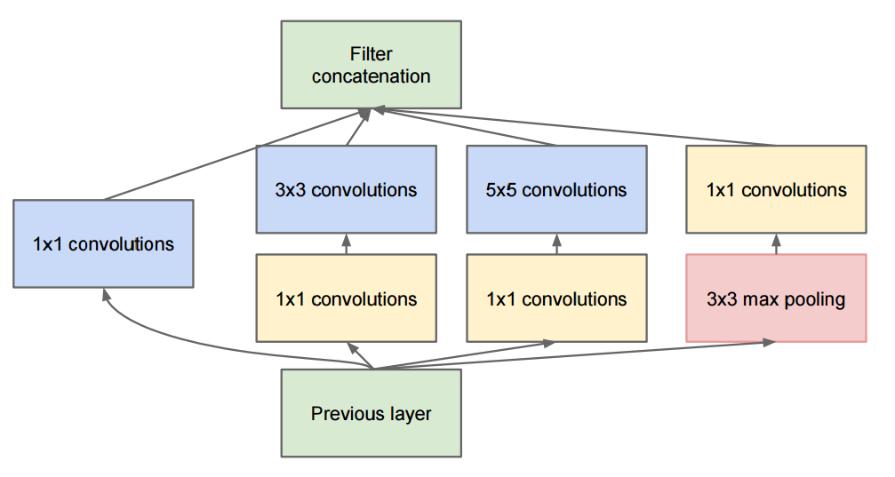
Improved Inception Idea
The net result is 3x3 and 5x5 convolutions won’t have as large of a volume to deal with. This can be thought of as a “pooling of features” because we are reducing the depth of the volume, similar to how we reduce the dimensions of height and width with normal max-pooling layers.

Slide 19
Summary of GoogleNet
Used 9 Inception modules in the whole architecture, with over 100 layers in total! Now that is deep…
No use of fully connected layers! They use an average pool instead, to go from a 7x7x1024 volume to a 1x1x1024 volume. This saves a huge number of parameters.
Uses 12x fewer parameters than AlexNet.
During testing, multiple crops of the same image were created, fed into the network, and the softmax probabilities were averaged to give us the final solution.
Trained on “a few high-end GPUs within a week”.

Slide 20
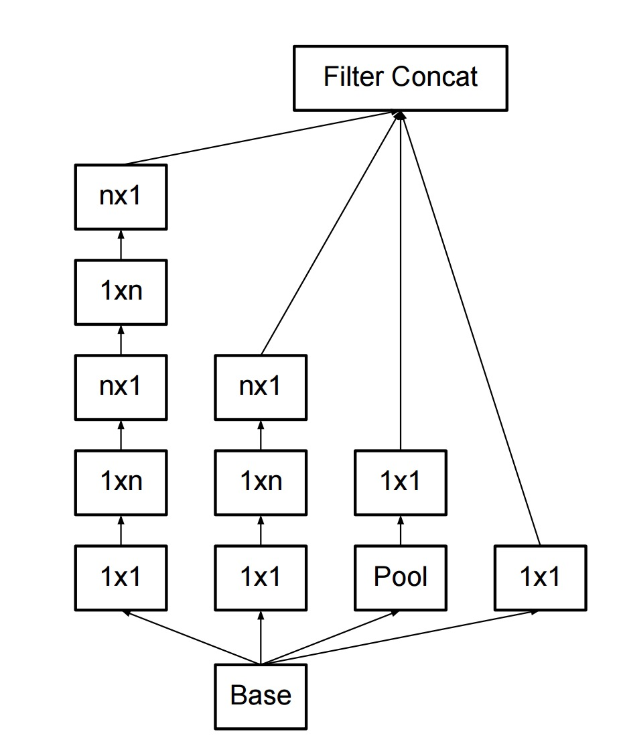
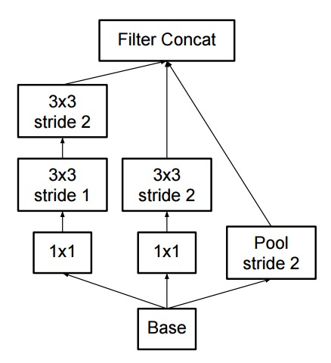
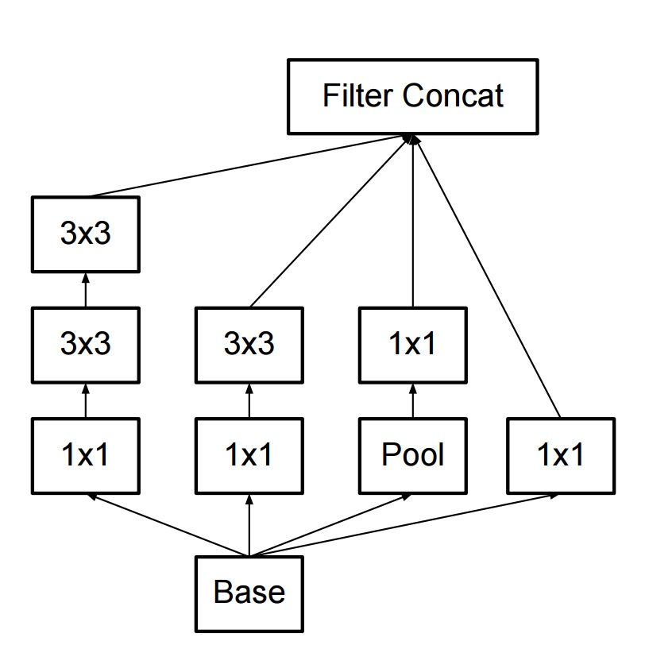
Inception v2, v3
Regularize training with batch normalization, reducing importance of auxiliary classifiers
More variants of inception modules with aggressive factorization of filters and increasing the number of feature maps while decreasing spatial resolution (pooling)

Slide 21
ResNet

Slide 22
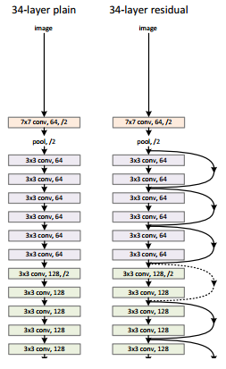
ResNet – ILSVRC 2015 winner
152 layer CNN
Reduced test error rate to 3.6%

Slide 23
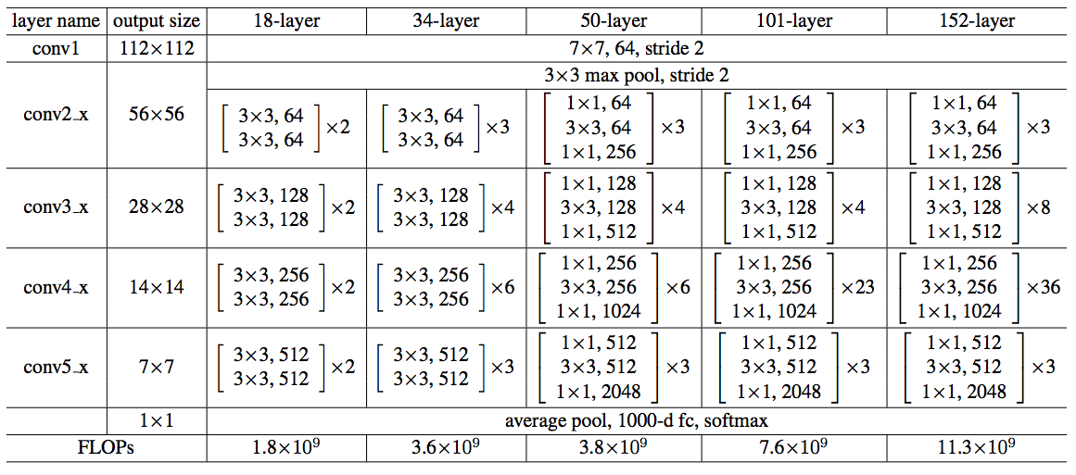
ResNet – ILSVRC 2015 winner

Slide 24
Issues with deeper networks
Does increasing the depth should increase the accuracy of the network, as long as over-fitting is taken care of?
No. The problem with increased depth is that the signal required to change the weights, which arises from the end of the network by comparing ground-truth and prediction becomes very small at the earlier layers, because of increased depth. It essentially means that earlier layers are almost negligible learned. This is called vanishing gradient.

Slide 25
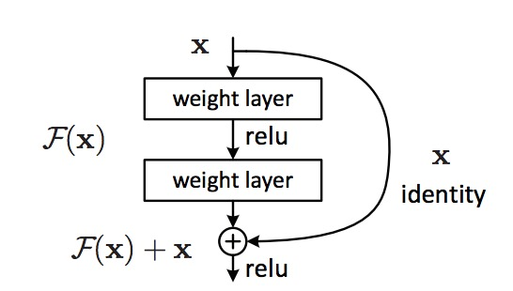
Residual module
A Residual Network, or ResNet is a neural network architecture which solves the problem of vanishing gradients in the simplest way possible.
If there is trouble sending the gradient signal backwards, why not provide the network with a shortcut at each layer to make things happen more smoothly

Slide 26
Residual module
In a traditional network the activation at a layer is defined as follows: y = f(x), where f(x) is our convolution, matrix multiplication, or batch normalization, etc. When the signal is sent backwards, the gradient always must pass through f(x), which can cause trouble due to the nonlinearities which are involved.
Instead, at each layer the ResNet implements: y = f(x) + x. The “+ x” at the end is the shortcut. It allows the gradient to pass backwards directly. By stacking these layers, the gradient could theoretically “skip” over all the intermediate layers and reach the bottom without being diminished.

Slide 27
Summary of ResNet
Ultra-deep with 152 layers…
Interesting note that after only the first 2 layers, the spatial size gets compressed from an input volume of 224x224 to a 56x56 volume.
The group tried a 1202-layer network, but got a lower test accuracy, presumably due to overfitting.
Trained on an 8 GPU machine for two to three weeks.

Slide 28
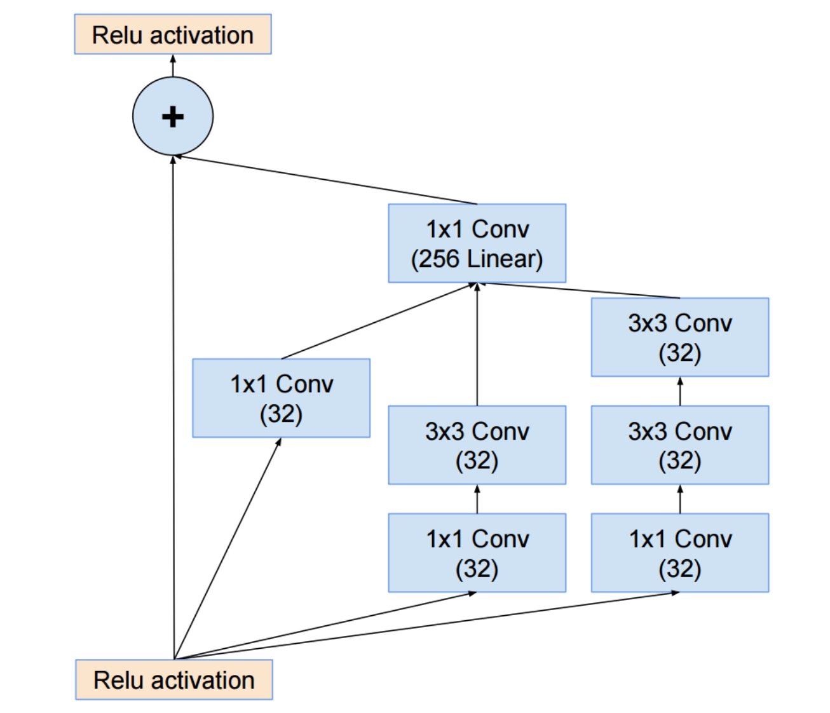
InceptionResNet

Slide 29
HighwayNet
It builds on the ResNet in a pretty intuitive way. The Highway Network preserves the shortcuts introduced in the ResNet, but augments them with a learnable parameter to determine to what extent each layer should be a skip connection or a nonlinear connection.

Slide 30
DenseNet
This architecture takes the insights of the skip connection to the extreme. The idea here is that if connecting a skip connection from the previous layer improves performance, why not connect every layer to every other layer? That way there is always a direct route for the information backwards through the network.

Slide 31
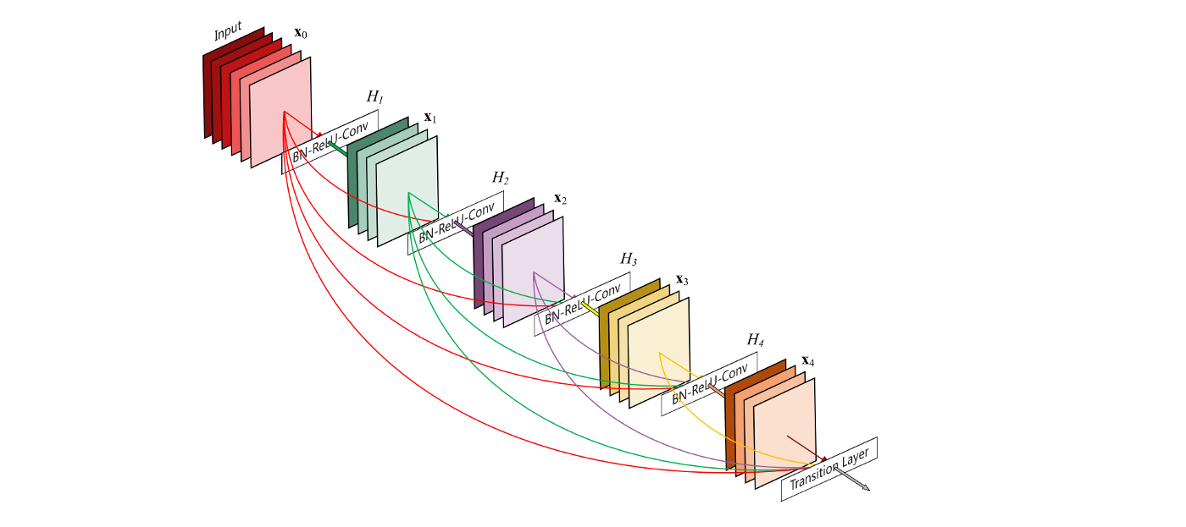
DenseNet

Slide 32
Summary of core ideas
Reduce filter sizes (except possibly at the lowest layer), factorize filters aggressively
Use 1x1 convolutions to reduce and expand the number of feature maps judiciously
Use skip connections and/or create multiple paths through the network

Slide 33
Keras support
Model | Image size | Weights size | Top-1 accuracy | Top-5 accuracy | Parameters | Depth
Xception | 299 x 299 | 88 MB | 0.790 | 0.945 | 22,910,480 | 126
VGG16 | 224 x 224 | 528 MB | 0.715 | 0.901 | 138,357,544 | 23
VGG19 | 224 x 224 | 549 MB | 0.727 | 0.910 | 143,667,240 | 26
ResNet50 | 224 x 224 | 99 MB | 0.759 | 0.929 | 25,636,712 | 168
InceptionV3 | 299 x 299 | 92 MB | 0.788 | 0.944 | 23,851,784 | 159
Inception ResNetV2 | 299 x 299 | 215 MB | 0.804 | 0.953 | 55,873,736 | 572
MobileNet | 224 x 224 | 17 MB | 0.665 | 0.871 | 4,253,864 | 88

Slide 34
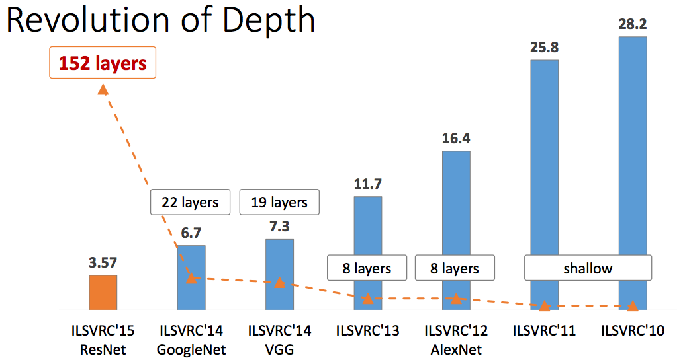
Summary of ImageNet competition

